Slide 1
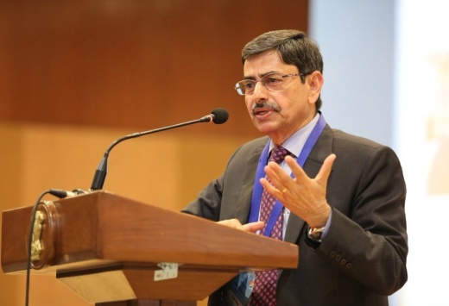
UNIT 3 – STATE ADMINISTRATION
GOVERNOR
Governor is a nominal executive head of the state. He forms an important part of the state executive where he acts as the chief executive head. Central Government nominates the governor for each state.
How is a Governor Appointed?
The Indian President appoints Governor for each state by warrant under his hand and seal. Central Government is responsible to nominate the governor for each state.
There is no direct or indirect election for the post of Governor
Term of the Governor’s office
His office has no fixed term.

Slide 2
UNIT 3 – STATE ADMINISTRATION
Who is qualified to become a Governor?
He should be an Indian Citizen
He should be 35 years old or more

Slide 3
UNIT 3 – STATE ADMINISTRATION
CONDITIONS OF GOVERNOR’S OFFICE
He cannot be a member of Lok Sabha and Rajya Sabha. If he has been a member of either of the house, he should vacate the seat on his first day as Governor in the office.
He should not hold any office of profit.
For his residence, Raj Bhavan is provided to him without the payment of rent.
Parliament decides his emoluments, allowances, and privileges.
When a governor is responsible for two or more states, the emoluments and allowances payable to him are shared by the states in such proportion as the President may determine.
Parliament cannot diminish his emoluments and allowances during his term of office.
He is given immunity from any criminal proceedings, even in respect of his personal acts
Arrest or imprisonment of the Governor cannot take place. Only civil proceedings can be initiated for his personal acts that too after giving two months’ of prior notice.

Slide 4
UNIT 3 – STATE ADMINISTRATION
EXECUTIVE POWERS OF THE GOVERNOR
Every executive action that the state government takes, is to be taken in his name.
How an order that has been taken up his name is to be authenticated, the rules for the same can be specified by the Governor.
He may/may not make rules to simplify the transaction of the business of the state government.
Chief Ministers and other ministers of the states are appointed by him.
He appoints the advocate general of states and determines their remuneration
State Election Commissioner
Vice-Chancellors of the universities in the state
He seeks information from the state government
A constitutional emergency in the state is recommended to the President by him.
The governor enjoys extensive executive powers as an agent of the President during the President’s rule in the state.

Slide 5
UNIT 3 – STATE ADMINISTRATION
LEGISLATIVE POWERS OF THE GOVERNOR
It’s in his power to prorogue the state legislature and dissolve the state legislative assemblies
He addresses the state legislature at the first session of every year
If any bill is pending in the state legislature, Governor may/may not send a bill to the state legislature concerning the same. For example, bill related to NEET.
If the speaker of the legislative assembly is absent and the same is Deputy Speaker, then Governor appoints a person to preside over the session
He can consult Election Commission for the disqualification of members
With respect to the bill introduced in the state legislature, he can:
Give his assent
Withhold his assent
Return the bill

Slide 6
UNIT 3 – STATE ADMINISTRATION
FINANCIAL POWERS AND FUNCTIONS OF THE GOVERNOR
He looks over the state budget being laid in the state legislature
His recommendation is a prerequisite for the introduction of a money bill in the state legislature
He recommends for the demand for grants which otherwise cannot be given
Contingency Fund of State is under him and he makes advances out that to meet unforeseen expenditure. (Download the notes on the types of funds in India from the linked article.)
State Finance Commission is constituted every five years by him. (Read about the Finance Commission of India in the linked article.)

Slide 7
UNIT 3 – STATE ADMINISTRATION
JUDICIAL POWERS OF THE GOVERNOR
He has the following pardoning powers against punishment:
Pardon
Reprieve
Respite
Remit
President consults the Governor while appointing judges of High Court.
In consultation with the state High Court, Governor makes appointments, postings, and promotions of the district judges.
In consultation with the state high court and state public service commission, he also appoints persons to the judicial services.

Slide 8

CHIEF MINISTER
Chief Minister is the real executive of the Government. Article 164 of the Constitution says that the Chief Minister shall be appointed by the governor.
Appointment of Chief Minister
Our constitution does not specifically mention about the qualification to be appointed as Chief Minister (CM).

Slide 9
CHIEF MINISTER
POWERS AND FUNCTIONS OF THE CHIEF MINISTER
He advises the Governor to appoint any person as a minister. It is only according to the advice of CM the Governor appoints ministers.
Allocation and reshuffling of portfolios among ministers.
In case of difference of opinion; he can ask minister to resign.
Directs, guides and controls activities of all the ministers.
If the Chief Minister resign then full cabinet has to resign.

Slide 10
CHIEF MINISTER
With Respect to State Legislature
All the policies are announced by him on the floor of the house.
He recommends dissolution of legislative assembly to the Governor.
He advises the Governor regarding summoning, proroguing the sessions of State Legislative Assembly from time to time.

Slide 11
CHIEF MINISTER
With Respect to State Legislature
All the policies are announced by him on the floor of the house.
He recommends dissolution of legislative assembly to the Governor.
He advises the Governor regarding summoning, proroguing the sessions of State Legislative Assembly from time to time.
Other Functions
At the ground level he is the authority to be in contact with the people regularly and know about their problems so as to bring about policies on the floor of the assembly.
He acts as the chairman of State Planning Commission.
He is the vice chairman of concerned zonal council in rotation for a period of one year.
During emergencies he acts as the crisis manager in the state.
From the above explanation it can be conclude that the Chief Minister of a state has wide range of functions. He is the leader of the MLAs elected by the general public of the state.

Slide 12
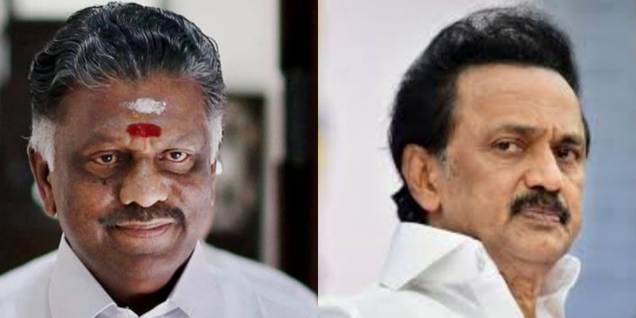
STATE COUNCIL OF MINISTERS
The state council is headed by the Chief Minister. The council comprises ministers appointed by the governor on the recommendation of the CM.
Composition of Council of Ministers
The size of the council is not mentioned in the Indian Constitution. Chief Minister decides the size and the rank of the ministers as per the requirement in the State Legislature.
Collective Responsibility
The provision of collective responsibility is dealt with by Article 164. The Article mentions that the council of ministers are collectively responsible to the state legislature. This means that all the ministers own joint responsibility to the legislative assembly for all their acts of omission and commission.
Acted as deputy chief ministers

Slide 13
STATE COUNCIL OF MINISTERS
The following articles of the Indian Constitution are important to be read by the aspirants for UPSC 2021. These articles are attached to the council of ministers. Refer to these in the table given below:
Articles | Provision
163 | Council of Ministers to aid and advise Governor
164 | Other provisions as to Ministers
166 | Conduct of business of the Government of a State
167 | Duties of Chief Minister as respects the furnishing of information to Governor, etc.

Slide 14
STATE LEGISLATURE
Unicameral State
It is a form of the legislature where only one house (one central unit) exists to make and implement laws for the state/country.
Bicameral State
In some of the States, the Legislature shall consist of two houses, namely, the Legislative Assembly and the Legislative Council.
Legislative Council in Tamil Nadu was abolished in 1986.
Bihar, Maharashtra, Karnataka, Andhra Pradesh, Telangana and Uttar Pradesh.
are having two houses

Slide 15
STATE LEGISLATURE
State Legislature – Legislative Assembly
The Legislative Assembly is the popularly elected chamber and is the real Centre of power in a State. The maximum strength of an assembly must not exceed 500 or its minimum strength fall below 60. But some of the States have been allowed to have smaller Legislative Assemblies, e.g. Sikkim, Arunachal Pradesh, Goa, etc.

Slide 16
STATE LEGISLATURE
State Legislature – Legislative Council
The Legislative Council of a State Comprises not more than one-third of the total number of members in the Legislative Assembly of the State and in no case less than 40 members. However, in Jammu and Kashmir, the strength is only 36. The system of the composition of the Council as provided for in the Constitution is not final. The final power is given to the Parliament of the Union.

Slide 17
STATE LEGISLATURE
Duration of Legislative Assembly & Legislative Council
The duration of the Legislative Assembly is five years. The Governor has the power to dissolve the Assembly even before the expiry of its term.
Unlike the Legislative Assembly, the Legislative Council is not subject to dissolution.
one-third of the total number of members of the Council would be elected by electorates consisting of members of local bodies like the municipalities and the district boards.
one-twelfth of the members would be elected by electorates comprising of graduates of the standing of three years dwelling in that particular state.
one-twelfth of the members would be elected by electorates consisting of teachers who have been in the teaching profession for at least 3 years.
one-third would be elected by members of the Legislative Assembly from amongst people who are not Assembly members.
The rest would be nominated by the Governor from persons having knowledge or practical experience in matters like science, literature, cooperative movement, art and social service. (The Courts can’t question the propriety or bonafide of the Governor’s nomination.)

Slide 18
STATE LEGISLATURE
Qualifications of Members of Legislative Assembly
A person shall not be qualified to be selected to occupy a seat in the Legislature of a State unless he/she
is an Indian citizen;
is 25 years or above for Legislative Assembly, and is 30 or above for Legislative Council,
possess such other qualifications as may be prescribed by the Parliament.
EDUCATIONAL QUALIFICATION?????

Slide 19
STATE LEGISLATURE
A person can be disqualified for being selected as and for being a member of the Legislative Assembly or Legislative Council of a State if he/she
holds an office of profit under GOI or any State Government, other than that of a Minister at the centre or any state or an office declared by a law of the State not to disqualify its holder (many States have passed such laws declaring certain offices to be offices the holding of which does not disqualify its holder for being a member of the Legislature of that States)
is mentally unsound as declared by a competent Court
is an undischarged insolvent
is not an Indian citizen or has voluntarily got the citizenship of a foreign State or is under any acknowledgement of adherence/allegiance to a foreign nation
is so disqualified by or under any law made by Parliament

Slide 20
STATE LEGISLATURE
OFFICERS OF THE STATE LEGISLATURE
Facts about Speaker & Deputy Speaker:
A Speaker vacates his office if he ceases to be a member of the Assembly.
He may also resign his office at any time.
A speaker may be removed from office by a resolution of the Assembly passed by a majority of all the then members of the Assembly after fourteen days’ notice of the intention to move such a resolution.
Speaker does not vacate his office on the dissolution of the Assembly.
He continues to be the Speaker until immediately before the first sitting of the Assembly after the dissolution.
The duties and powers of the Speaker are, broadly speaking the same as those of the Speaker of the House of the People (Lok Sabha).

Slide 21
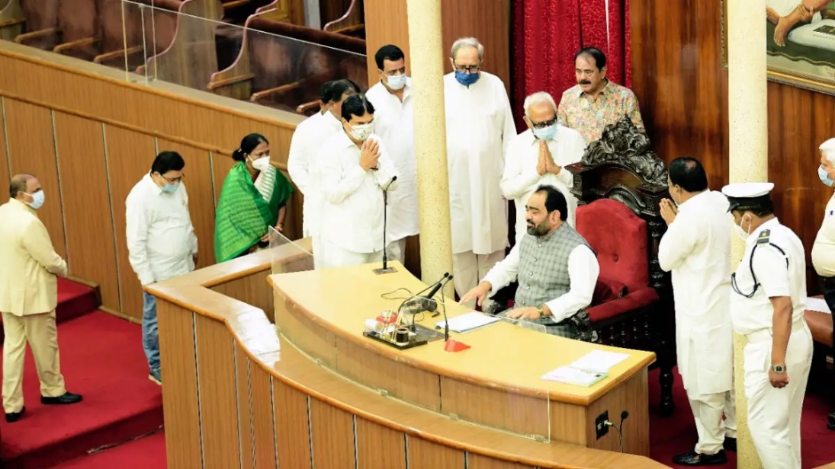
STATE LEGISLATURE
Some other powers of the State Assembly are as under:
It elects its Speaker as well as Deputy Speaker. It can also remove them by a no-confidence vote.
It participates in the election of India’s President.
It also considers reports presented by agencies such as the Auditor-General, State Public Service Commission, and others. Hence, it is evident that the Vidhan Sabha is the powerful and popular chamber of the State Legislature. In theory, it is somewhat parallel to the Lok Sabha.

Slide 22
STATE LEGISLATURE
Limitations on the powers of State Legislature
Certain types of Bills cannot be moved in the State Legislature without the previous sanction of the President of India.
Certain Bills passed by the State Legislature cannot become operative until they receive the President’s assent after having been reserved for his consideration by the Governor
Parliament can exercise the power to make laws for the whole or any part of the territory of India with respect to any of the matters enumerated in the State List, while a Proclamation of emergency is in operation

Slide 23
STATE LEGISLATURE
Legislative Procedure
The State Legislature must meet at least twice a year and the interval between any two sessions should not be more than six months.
The Governor delivers the opening address at the beginning of a new session in which he outlines the policy of the State Government.
Any Bill may be introduced in either House of the Legislature except a Money Bill, which can be introduced only in the Assembly. It has to go through three readings, after which it goes to the Governor for his assent. The Governor may send it back for reconsideration but once it is passed again by the Legislature, he cannot withhold his assent.
He may reserve certain Bills for the consideration of the President, who may ask him to place it before the Legislature for reconsideration. When it is passed again with or without amendment it goes to the President for his consideration.
But in case of Bills which have been duly passed by the Assembly, if there is only one House in the State, and by the Assembly and the Council where there are two House, and is awaiting the assent of the Governor or the President it does not lapse.
A bill which has been returned either by the Governor or the President for reconsideration can be considered and passed by the newly constituted Assembly, even though the Bill was originally passed by the dissolved House.

Slide 24
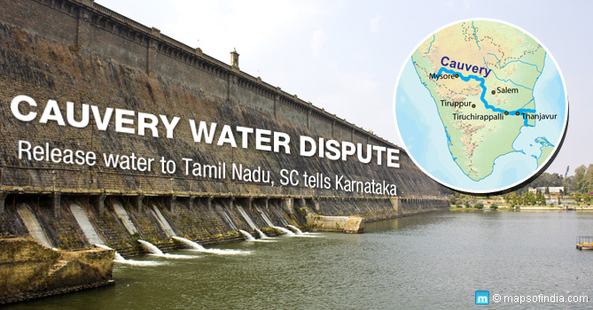
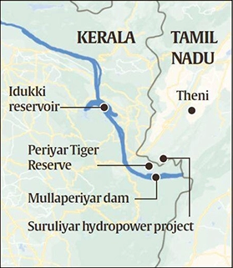
INTER STATE RELATIONSHIPS
Ensuring Coordination through Inter-State councils
Article 263 of the Indian Constitution empowers the President to lay down the duties of an inter-state council. In other words, Article 263 provides for the formation of Inter-State councils by the President of India.
Article 263 assigns duties to the intern-state councils which can be read as-
The Inter-State councils are charged with making recommendations for the efficient coordination of action and policy with respect to a particular subject.

Slide 25
INTER STATE RELATIONSHIPS
Key points
The function of the Inter-State Council is advisory in nature while dealing with any dispute whether legal or non-legal unlike that of the Supreme Court of India whose decision is binding.
Under Article 131 the Supreme Court exercises its jurisdiction to make decisions upon the disputes arising between the governments.
The Sarkaria Commission was set up on Centre-State Relations in 1883-88 and the commission strongly recommended the establishment of a permanent Inter-State Council under Article 263 of the Indian Constitution.
However, the Commission made the recommendation to call the Council an intergovernmental council to differentiate it from the other bodies established under the purview of Article 263.

Slide 26
INTER STATE RELATIONSHIPS
Composition of the Council
The recommendations of the Sarkaria Commissions were considered by the then Janata Dal Government which was headed by V.P. Singh, in the establishment of the Inter-State Council in 1990.
The council consists of the following members
(i) Prime Minister who is also the Chairman of the Council
(ii) Chief Ministers of all the states of the Union
(iii)Chief Ministers of the Union Territories with a legislative assembly
(iv) Administrators of the Union Territories which don’t have a legislative assembly
(v) Governors of the states under President’s rule

Slide 27
INTER STATE RELATIONSHIPS
Duties of the Council
The council promotes coordination between the governments
Holding discussions
Advising the government through recommendations
Discussing matters of common interest suggested being deliberated on by the Chairman.
The Inter-State Council is the only intergovernmental centre-state platform that functions directly inside the constitutional framework (Article 263 (b) and (c)), where current issues such as disaster management, terrorism, and internal security and matters like GST can be discussed.
The council solves tensions between the states or the Centre-state and builds trust between the governments. At least, the council functions as a safety valve in times of serious concerns.
Challenges to the Inter-State Council
One of the major issues is that the inter-state council is underutilized. Since its establishment in 1990, the Council has met only around 10 times and has made only a little progress in resolving the disputes between the states.
The council has only little participation in civil society which reduces its coordinative and participatory capacities.
The biggest challenge faced by the Inter-state council is that its recommendations are not binding either on the states or the Centre. Hence, the role of the council is often limited to a merely advisory body, whose recommendations are often ignored by the governments.

Slide 28
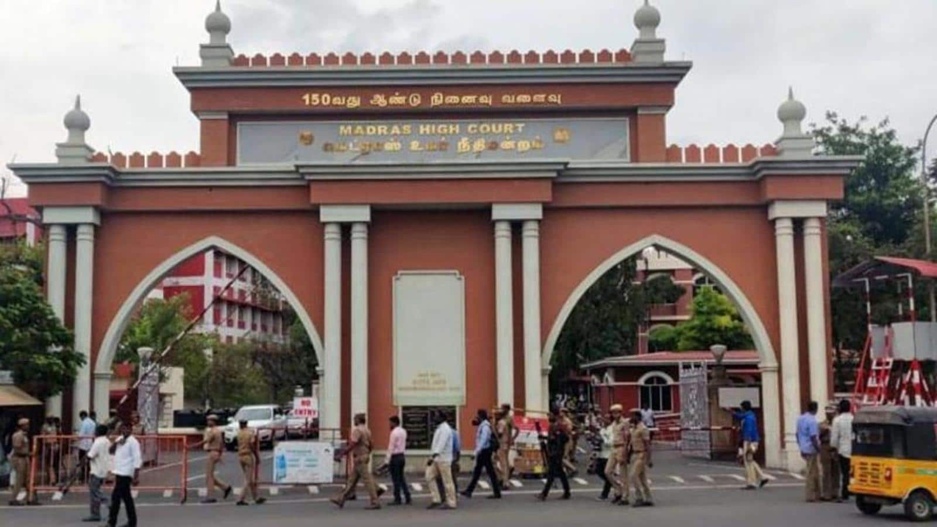
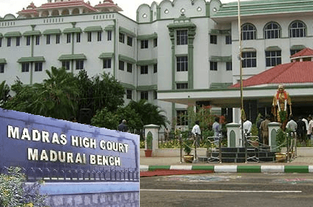
STATE JUDICIARY – HIGH COURT
High Courts are the highest courts in a state.
Powers and Functions of the High Court
Articles 214 to 231 in the Indian Constitution talk about the High Courts, their organisation and powers.
The Parliament can also provide for the establishment of one High Court for two or more states.
The northeastern states also have one common High Court.
In addition, Tamil Nadu shares a High Court with Puducherry.

Slide 29
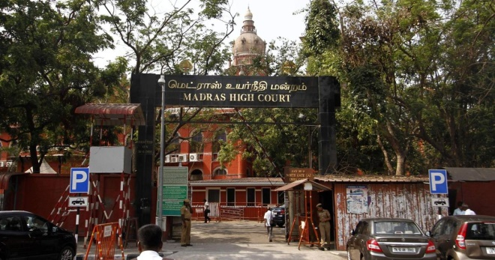
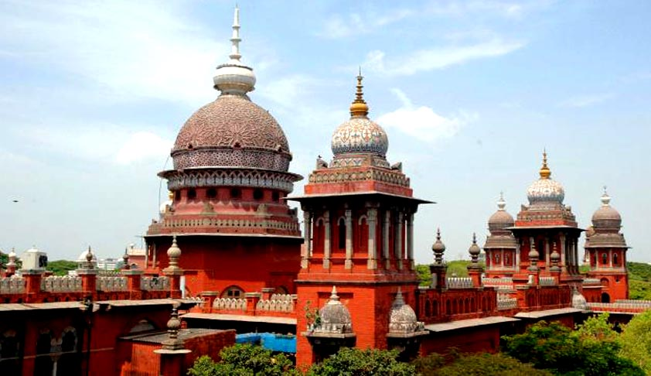
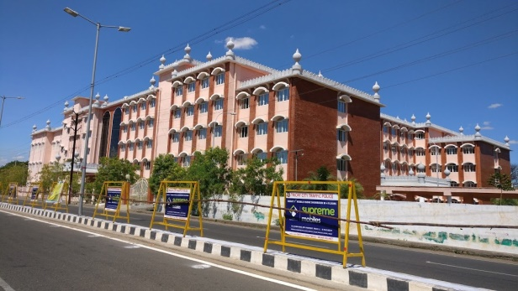
HIGH COURT POWERS
Administrative Powers
It superintends and controls all the subordinate courts.
It can ask for details of proceedings from subordinate courts.
It issues rules regarding the working of the subordinate courts.
It can transfer any case from one court to another and can also transfer the case to itself and decide the same.
It can enquire into the records or other connected documents of any subordinate court.
It can appoint its administration staff and determine their salaries and allowances, and conditions of service.

Slide 30
HIGH COURT POWERS
High Court Autonomy
High Court judges enjoy the security of tenure till the age of retirement, which is 62 years.
Salaries and allowances: The High Court judges enjoy good salaries, perks and allowances and these cannot be changed to their disadvantage except in case of a financial emergency.
The expenses of the High Court are charged on the Consolidated Fund of the State, which is not subject to vote in the state legislature.
Powers: The Parliament and the state legislature cannot cut the powers and jurisdiction of the High Court as guaranteed by the Constitution.
Conduct of judges: Unless a motion of impeachment has been moved, the conduct of the High Court judges cannot be discussed in the Parliament.
Retirement: After retirement, High Court judges cannot hold an office of emolument under the Government of India or that of a state. There is an exception to this clause, however, when, with the consent of the Chief Justice of India, retired judges can be nominated to a temporary office, and in the situation of emergencies.

Slide 31
UNIT 4 – URBAN AND LOCAL ADMINISTRATION
DISTRICT’S ADMINISTRATION HEAD
The District administration is headed by the District Collector/Deputy Commissioner, drawn from IAS and he is responsible among others for the general control and direction of the police.
Prevailing Administrative Structure
Administration of regulatory functions under the leadership of the Collector and District Magistrate, such as law and order, land revenue / reforms, excise, registration, treasury, civil supplies and social welfare.
District / Sub-district level offices of the line departments of the State Government and their agencies, such as PWD, irrigation, health, industries etc.
Local bodies (Panchayati Raj Institutions and Municipal bodies) which, after the 73rd and 74th amendment of the Constitution, have become the third tier of government.

Slide 32
UNIT 4 – URBAN AND LOCAL ADMINISTRATION
Functions of Collector
Conduct of elections, dealing with calamities, supervising local government institutions, revenue administration,

Slide 33
UNIT 4 – URBAN AND LOCAL ADMINISTRATION
Need of Reforms in District Administration
Union-State and Local relations: Implementation of welfare/development activities of both the Centre and the state in the respective district.
Imperatives of development management: India specifically needs to shift its focus from development administration to a more efficient development management perspective and practice in order to remain in the League of Nations competing for implementation of International development programs. For this many courses as well as programmes are being rolled out by the country's education system as well as sponsored by the international organizations.
Law and order administration

Slide 34
UNIT 4 – URBAN AND LOCAL ADMINISTRATION
Modernizing the Office of the District Collector
Grievance & Public Feedback Cell-Grievance redressal of citizens and implementation of citizen charters should be an integral part of the Collector’s office.
Management Information Systems / IT tools /E-Governance for effective monitoring and evaluation of programme/projects which are directly under the charge of the Collector, there needs to be computerized/MIS attached to his office.
A Vigilance Cell should be there.
Civil Society & Media Cell should be there.

Slide 35
UNIT 4 – URBAN AND LOCAL ADMINISTRATION
Functional and Structural Reform
a) Formation of Institutions of Local Governance at the District Level.
b) Each district should have a District Council comprising of representatives of both rural and urban bodies.
c) The District Collector should have a dual role in this government structure. He should work as the Chief Officer of the District Council and should be fully accountable to the District Council on all local matters.
Other Reforms
a) There should be a special RTI Cell in the office of the Collector.
b) Officers may be posted as District Magistrates early in their career, but in complex and problem-prone districts an IAS officer should be posted as DM only on completion of 10-12 years of service.
c) Steps should be taken to ensure that the Collector plays an effective coordination role in activities and programmes of other departments at the district level.

Slide 36
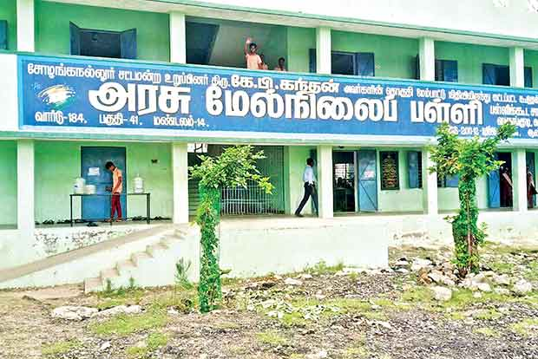
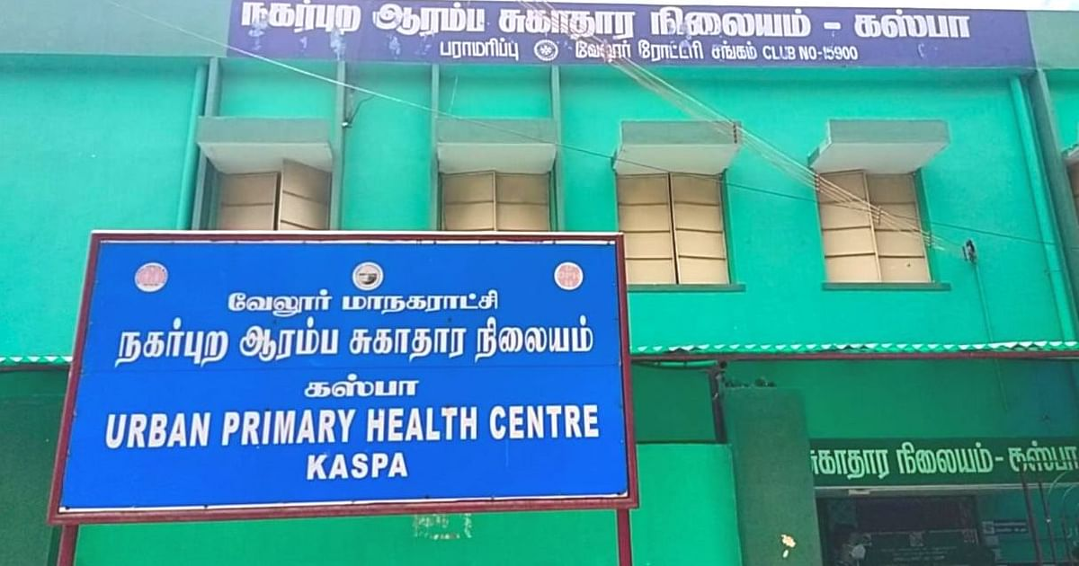
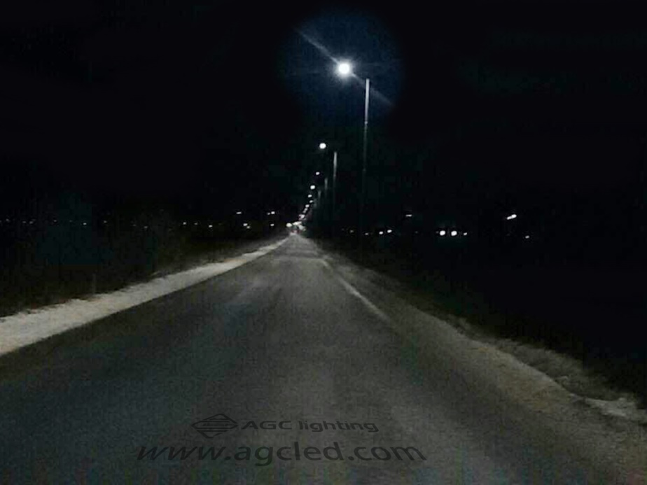
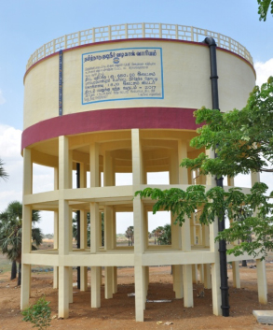
UNIT 4 – URBAN AND LOCAL ADMINISTRATION
MUNICIPALITY

Slide 37
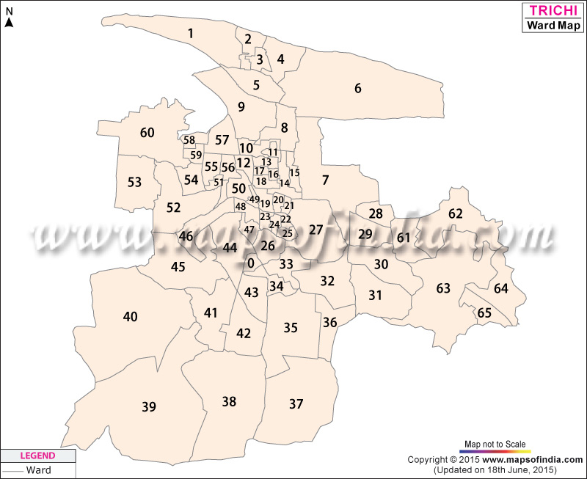
MUNICIPAL COROPORATAION
Municipal Corporations are local level governments in India. It’s also called as Mahanagar Palika, Nagar Palika, Nagar Nigam, City Corporation, etc. A city is administered by a Municipal Corporation if the population of that city exceeds one billion.
Municipal Corporations are largely dependent on the property tax collected for their revenue. The other sources of revenue include water tax, professional tax, drainage tax, etc and some fixed aid from the state government.
Composition of the
Municipal Corporation
Councillors
Mayor
The Mayor heads the Municipal Corporation. The corporation remains under the charge of Municipal Commissioner. The Executive Officers along with the Mayor and Councillors monitor and implement the programs related to planning the development of the corporation.

Slide 38
FUNCTIONS OF THE MUNICIPAL CORPORATION
Urban planning including town planning.
Regulation of land-use and construction of buildings.
Planning for economic and social development
Water supply for domestic, industrial and commercial purposes.
Public health, sanitation conservancy, and solid waste management.
Fire services.
Urban forestry, protection of the environment and promotion of ecological aspects.
Safeguarding the interests of weaker sections of society, including the handicapped and mentally retarded.
Slum improvement and up-gradation.
Urban poverty alleviation.

Slide 39
MUNICIPAL CORPORATION
Who conducts Municipal Corporation Elections?
The elections to the Municipal Corporations are conducted under the guidance, direction, superintendence and control of the State Election Commission
Qualification for contesting Municipal Corporation elections
A person can contest elections for Municipal Corporation if he/she fulfills the following criteria:
She/he must be a citizen of India
She/he must have attained the age of 21 years
His/her name is registered in the Electoral Roll of a ward
She/he is not earlier disqualified for contesting Municipal Corporation elections.
She/he must not be an employee of any Municipal Corporation in India
The Term of a Municipal Corporation
FIVE YEARS

Slide 40
MUNICIPAL CORPORATION
ROLES AND DUTIES OF A COUNCILLOR
The Councillors under the Municipal Corporations perform the following duties:
To work towards the welfare and interests of the municipality as a whole.
To participate in the council meetings, council committee meetings and meetings of other related bodies.
To participate in developing and evaluating the programs and policies of the municipality
To keep the privately discussed matters in council meetings in confidence.
To get all the information from the chief administrative officer about the operation and administration of the municipality.
To perform any other similar or necessary duties.

Slide 41
CHAIRMAN AND ELECTED REPRESENTATIVES
Municipal councillors are the elected members of the local municipal corporations and the representatives of the citizens in a fixed place.
They are elected during the local body elections held in each state every five years.
They represent a local political party or fight as independents who do not represent any political organization.

Slide 42
CHAIRMAN AND ELECTED REPRESENTATIVES
Responsibilities of Municipal Councillors
They are chosen during the local body elections, which are held every five years in each state.
Taking part in the creation and assessment of the municipality's programmes.
Working to advance the rights and interests of the citizens in the local governments they have been chosen to represent.
Take part in the municipal mayor's election.
Take care of civic-related issues like road construction, infrastructure development, issues with town planning, and waste management disposal.
Activities that support education, public health regulations, the welfare of the community, public safety, and other local development issues.
Promote development-related, cultural, and other aesthetic-focused programmes.
Approval of regional planning initiatives.
Pay attention to the problems locals are having, then deal with them.

Slide 43
CHAIRMAN AND ELECTED REPRESENTATIVES
PANCHAYAT RAJ
EVOLUTION OF PANCHAYATI RAJ
The Constitution of India in Article 40 enjoined: “The state shall take steps to organise village panchayats and endow them with such powers and authority as may be necessary to enable them to function as units of self-government”.
There were a number of committees appointed by the Government of India to study the implementation of self-government at the rural level and also recommend steps in achieving this goal.
The committees appointed are as follows:
Balwant Rai Mehta Committee
Ashok Mehta Committee
G V K Rao Committee
L M Singhvi Committee

Slide 44
CHAIRMAN AND ELECTED REPRESENTATIVES
Balwant Rai Mehta Committee
The committee was appointed in 1957, to examine and suggest measures for better working of the Community Development Programme and the National Extension Service. The committee suggested the establishment of a democratic decentralised local government which came to be known as the Panchayati Raj.
Recommendations by the Committee:
Three-tier Panchayati Raj system: Gram Panchayat, Panchayat Samiti and Zila Parishad.
Directly elected representatives to constitute the gram panchayat and indirectly elected representatives to constitute the Panchayat Samiti and Zila Parishad.
Panchayati Raj system → Planning and development are the primary objectives
Panchayat Samiti → Executive body
Zila Parishad → Advisory and supervisory body
District Collector to be made the chairman of the Zila Parishad.
It also requested for provisioning resources so as to help them discharge their duties and responsibilities.

Slide 45
CHAIRMAN AND ELECTED REPRESENTATIVES
Ashok Mehta Committee & Panchayati Raj
The committee was appointed in 1977 to suggest measures to revive and strengthen the declining Panchayati Raj system in India.
The key recommendations are:
The three-tier system should be replaced with a two-tier system: Zila Parishad (district level) and the Mandal Panchayat (a group of villages).
Zila Parishad should be the executive body and responsible for planning at the district level.
The institutions (Zila Parishad and the Mandal Panchayat) to have compulsory taxation powers to mobilise their own financial resources.

Slide 46
CHAIRMAN AND ELECTED REPRESENTATIVES
G V K Rao Committee & Panchayati Raj
The committee was appointed by the planning commission in 1985. It recognised that development was not seen at the grassroot level due to bureaucratisation resulting in Panchayat Raj institutions being addressed as ‘grass without roots’. Hence, it made some key recommendations which are as follows:
Zila Parishad to be the most important body in the scheme of democratic decentralisation.
Zila Parishad to be the principal body to manage the developmental programmes at the district level.
The district and the lower levels of the Panchayati Raj system to be assigned with specific planning, implementation and monitoring of the rural developmental programmes.
Post of District Development Commissioner to be created. He will be the chief executive officer of the Zila Parishad.
Elections to the levels of Panchayati Raj systems should be held regularly.

Slide 47
CHAIRMAN AND ELECTED REPRESENTATIVES
L M Singhvi Committee & Panchayati Raj
The committee was appointed by the Government of India in 1986 with the main objective to recommend steps to revitalise the Panchayati Raj systems for democracy and development. The following recommendations were made by the committee:
The committee recommended that the Panchayati Raj systems should be constitutionally recognised. It also recommended constitutional provisions to recognise free and fair elections for the Panchayati Raj systems.
The committee recommended reorganisation of villages to make the gram panchayat more viable.
It recommended that village panchayats should have more finances for their activities.
Judicial tribunals to be set up in each state to adjudicate matters relating to the elections to the Panchayati Raj institutions and other matters relating to their functioning.

Slide 48
CHAIRMAN AND ELECTED REPRESENTATIVES
73rd Constitutional Amendment Act of 1992
Salient Features of the Act
Gram Sabha: Gram Sabha is the primary body of the Panchayati Raj system. It is a village assembly consisting of all the registered voters within the area of the panchayat.
Three-tier system: The Act provides for the establishment of the three-tier system of Panchayati Raj in the states (village, intermediate and district level). States with a population of less than 20 lakhs may not constitute the intermediate level.
Election of members and chairperson: The members to all the levels of the Panchayati Raj are elected directly and the chairpersons to the intermediate and the district level are elected indirectly from the elected members and at the village level. The Chairperson is elected as determined by the state government.

Slide 49
CHAIRMAN AND ELECTED REPRESENTATIVES
73rd Constitutional Amendment Act of 1992
Reservation of seats:
For SC and ST: Reservation to be provided at all the three tiers in accordance with their population percentage.
For women: Not less than one-third of the total number of seats to be reserved for women, further not less than one-third of the total number of offices for chairperson at all levels of the panchayat to be reserved for women.

Slide 50
CHAIRMAN AND ELECTED REPRESENTATIVES
73rd Constitutional Amendment Act of 1992
Duration of Panchayat: The Act provides for a five-year term of office to all the levels of the panchayat. However, the panchayat can be dissolved before the completion of its term. But fresh elections to constitute the new panchayat shall be completed –before the expiry of its five-year duration.
Disqualification: A person shall be disqualified for being chosen as or for being a member of panchayat if he is so disqualified –
Under any law for the time being in force for the purpose of elections to the legislature of the state concerned.
Under any law made by the state legislature. However, no person shall be disqualified on the ground that he is less than 25 years of age if he has attained the age of 21 years.

Slide 51
CHAIRMAN AND ELECTED REPRESENTATIVES
73rd Constitutional Amendment Act of 1992
State election commission:
The commission is responsible for superintendence, direction and control of the preparation of electoral rolls and conducting elections for the panchayat.
The state legislature may make provisions with respect to all matters relating to elections to the panchayats.
Powers and Functions: The state legislature may endow the Panchayats with such powers and authority as may be necessary to enable them to function as institutions of self-government. Such a scheme may contain provisions related to Gram Panchayat work with respect to: the preparation of plans for economic development and social justice.

Slide 52
CHAIRMAN AND ELECTED REPRESENTATIVES
73rd Constitutional Amendment Act of 1992
Finances:
The state legislature may –
Authorize a panchayat to levy, collect and appropriate taxes, duties, tolls and fees.
Provide for making grants-in-aid to the panchayats from the consolidated fund of the state.
Provide for the constitution of funds for crediting all money of the panchayats.
Finance Commission: The state finance commission reviews the financial position of the panchayats and provides recommendations for the necessary steps to be taken to supplement resources to the panchayat.
Audit of Accounts: State legislature may make provisions for the maintenance and audit of panchayat accounts.
Application to Union Territories: The President may direct the provisions of the Act to be applied on any union territory subject to exceptions and modifications he specifies.

Slide 53
CHAIRMAN AND ELECTED REPRESENTATIVES
73rd Constitutional Amendment Act of 1992
Exempted states and areas: The Act does not apply to the states of Nagaland, Meghalaya and Mizoram and certain other areas. These areas include,
The scheduled areas and the tribal areas in the states
The hill area of Manipur for which a district council exists
Darjeeling district of West Bengal for which Darjeeling Gorkha Hill Council exists.
However, Parliament can extend this part to these areas subject to the exception and modification it specifies. Thus, the PESA act was enacted.

Slide 54
CHAIRMAN AND ELECTED REPRESENTATIVES
PESA Act of 1996- mainly for tribal areas
OBJECTIVES
To provide self-rule for the tribal population.
To have village governance with participatory democracy.
To evolve participatory governance consistent with the traditional practices.
To preserve and safeguard traditions and customs of tribal population.
To empower panchayats with powers conducive to tribal requirements.
To prevent panchayats at a higher level from assuming powers and authority of panchayats at a lower level.
The Panchayati Raj system constitutes an integral part of the IAS prelims and UPSC mains syllabus.

